Slide 1
Introduction to Git/GitHub and Shiny
Ran Li
11/29/2021

Slide 2
Lecture Overview
Introduce Git/GitHub
Demo GitHub repository: https://github.com/rl627/dornsife-github-shiny-intro
Shiny Intro Lab: https://github.com/rl627/dornsife-github-shiny-intro/discussions/categories/shiny-steps
Review

Slide 3
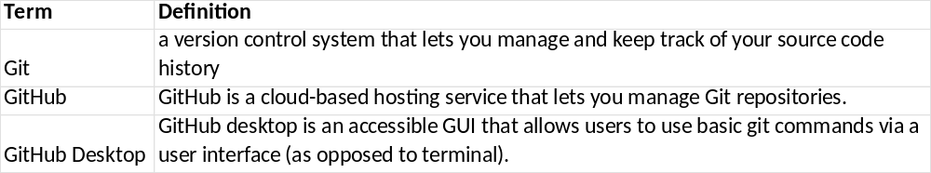
Introduce Git/GitHub
Takeaway: Hardly anyone understands these words without seeing it in action. Let’s go into the wild and explore a demo GitHub Repository.

Slide 4
Demo GitHub repository
Why use Git/GitHub:
  Can track your codebase development
  If you mess up you can revert to a previous state
  Industry standard for collaborative project
  Easy and modern way to share code and projects
  Package/Application/Website deployment
Demo repo: https://github.com/rl627/dornsife-github-shiny-intro

Slide 5
Shiny Intro Lab
Shiny Intro Lab: https://github.com/rl627/dornsife-github-shiny-intro/discussions/categories/shiny-steps
Please go in order from Steps 0 to Step 9

Slide 6
Review
Here are somethings which were introduced today
Git/GitHub
  Example of how Git/GitHub can be used to share code
  How to Fork a repository
  How to use GitHub Desktop to commit to a repository
Shiny
  Why a Shiny App might be useful
  Basic UI elements
  Translate R code into a basic web application

